Slide 1
Teensy Propagation Simulator Project Rick Muething, KN6KB, Tom Lafleur, KA6IQA April 29 2020
This PP presentation describes and initially documents a project for the development of a HF and VHF propagation simulator based on the Teensy 4.0 processor + sound card chip.
Objectives:
1) Evaluate the latest Teensy CPU,Audio components and Audio library.
2) Provide an easy to duplicate, easy to use, low cost channel simulator to allow development, optimization, and characterization of HF and VHF modems and protocols.

Slide 2
Background
Audio simulators have been used extensively in the development, comparison, and enhancement of HF and VHF protocols
Most are based on modeling the propagation effects (noise, multipath, fade, etc.) using the Waterson model or some variation of it.
About 1998 Winlink purchased a fairly simple and low cost (~$700) simulator built around an Analog Devices DSP demo board. This project was designed and built by Johan Forrer, KC7WW an engineer at Harris. The product had some limitations (mostly due to the Analog Devices board capability) but was quite useful and modeled basic WGN (white gaussian noise) and Multi path channels (“standardized” HF channels for MPG, MPM and MPP ( multipath good, moderate and poor). The simulator was used in the development of SCAMP, WINMOR, Early ARDOP and comparison of various Pactor protocols.
The simulator finally died around 2015 and the Analog Device DSP board is no longer available.
There are a few commercial simulators (mostly used/built by Harris, Motorola etc. for evaluation of HF and VHF protocols and modems but theses are typically $8-30K instruments and are fairly complex to setup and operate.

Slide 3
Low Cost Channel Simulator Objectives
Provides simulation for all standard HF & VHF channel models (WGN, FLAT FADING , MPG, MPM, MPP, MPDisturbed)
1 or 4 path (ray) modeling options Audio Bandwidths 100- 3300 Hz and 100 - 6300 Hz.
Separate I and Q channel modeling.(Waterson Propagation Model with CCIR 2 sigma normal distribution of delays)
WGN S:N -40 to + 40 dB, 1 dB steps (allows evaluating new protocols for very low power/weak signal (JT modes etc.)
Tuning offset and slow drift modeling capability to evaluate modems using SSB
Flat Fading with programmable rates for VHF/UHF FM modeling
Ability to model a half duplex connection using a single simulator. (Two simulators are required for full duplex or non symmetric path half duplex modeling.)
Automatic self test and calibration confirmation.
Low cost. Easy to build. Easy to learn. Easy to operate.

Slide 4
Teensy Simulator Function and Flexibility Summary
Common “standardized” modes: WGN(1 path) or MPG,MPM,MPP,MPD(2 paths I & Q, 4 total paths)
WGN added (S:N -40 to +40 dB) to all common modes.
Fading (0-40 dB, 0-100 Hz) can be applied to all common modes (useful for VHF/UHF modeling)
Static Frequency offset (-200 to +200Hz) can be applied to all common modes. (auto tune modeling/testing)
VLF FM (0 to +/100Hz deviation, 0-100Hz rate) can be applied to all common modes (drift and doppler modeling)
Individual gain adjust on all audio inputs (2) and outputs(2)
Spectrum (0-3.5 KHz and 0-6.5KHz plots)
Dynamic IQ Plane delay plots (MPG, MPM, MPP, MPD)
Built in Test/measurement for calibration tests and self check.

Slide 5
Ionos Sim 4 Path Channel Simulator
Simplified block Diagram
Rev11 4/29/2020
Rick Muething, KN6KB
Channel Spread Delay Fade Depth
Type Hz
WGN 0 0 ms
FADE (FLAT) 0 0 to 40 dB
MPG .1 .5 ms
MPM .5 1 ms
MPP 1 2 ms
MPD 2.5 5 ms
Audio In #1 (mono) LINEINL
input
UP Mixer
7.5 KHz LO
Test Tone
Audio In #2 (mono)
LINEINR
Commands
Control Panel or USB Serial
FIR HP
7.9-22 KHz
mixAudioSel
mixer
0
white
Set Ch Type,S:N
(-40 to + 40 dB S:N,
mixer gains
p-p measure
CH 1: I, Q
and
CH 2: I , Q
Channels
Processing
1
multiply
LP FIR
LP FIR filter
offset
p-p measure
VLF drift
sine
freq dev
0
1
~7500 Hz L.O.
Down mixer
mixChannels
amp Right
Output Level settings
Legend:
amp Left
Teensy Library
Audio Component
Testing and
calibration
Collection of
Audio Components
p-p measure
Simulated Channels
Audio Out
p-p measure
Audio
Control

Slide 6
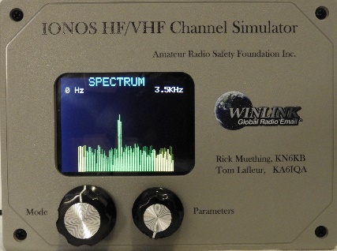
Ionos Sim 4 Path HF/VHF Channel Simulator
Simplified block Diagram
Channel Spread Delay Fade Depth
Type Hz
WGN 0 0 ms
FADE (FLAT) 0 0 to 40 dB
OFFSET/FM Deviation up to 200 Hz
MPG .1 .5 ms
MPM .5 1 ms
MPP 1 2 ms
MPD 2.5 5 ms
Teensy 4.0 uP, 600 MHz
2 Rotary Encoders
Stereo Sound card chip (44.1KHz)
Buffer amps
TFT Graphics display
Desired S:N
-40 to + 40 dB
WGN + 3 or 6 KHz LPF
p-p meas
rms meas
S:N Mixer
Buffer
Amps
Output
Level
Adjust
d
Audio In #1
d
input
Select/
gain
adjust
Up/Down Mixers
and filters
(For Freq Offset
and slow FM
Modulation)
Audio Out #1
d
Test Tone
I and Q Delay processing
(4 channels)
Audio In #2
Audio Out #2
Implemented using 32 Teensy Audio/DSP Library Components

Slide 7
Input Detail
Input
mixInpSel
Test oscillator injection 86 to 6300 Hz
(Testing and calibration)
sine
mixer
0
FIR LP
Filter
0 – 3400 Hz
or
0 -6300 Hz
Audio In #1 (mono)
Input Protection
And buffering
1.8 Vpp Max
2
Audio In #2 (mono)
[Second audio input allows half duplex testing using a single simulator without need for an external mixer. ]
3
p-p measure
p-p measure
Input Gain Level settings
Testing and calibration

Slide 8
Channels Detail
CH 1: I, Q
and
CH 2: I, Q
Channels Processing
Delay control code ¹
(based on channel type modeled)
Audio in
From
mixAudioSel
Q1
mixIQ ²
HilbertQ12 FIR
delay Q1
0
Audio out
To channels
mixer
Q2
delay Q2
2
FIR LP
I1
1
delay I1
I2
3
delay I2
1 Equalizes I delay path for HilbertQ12 filter delay (~1.3605 ms )
Determines magnitude and rate of change to I and Q delays based on channel being modeled.
Modulates delays with normally distributed random values based on channel being modeled
2 Compute mixIQ gains based on I1, Q1, I2, Q2 delays to combine paths back to In-phase

Slide 9
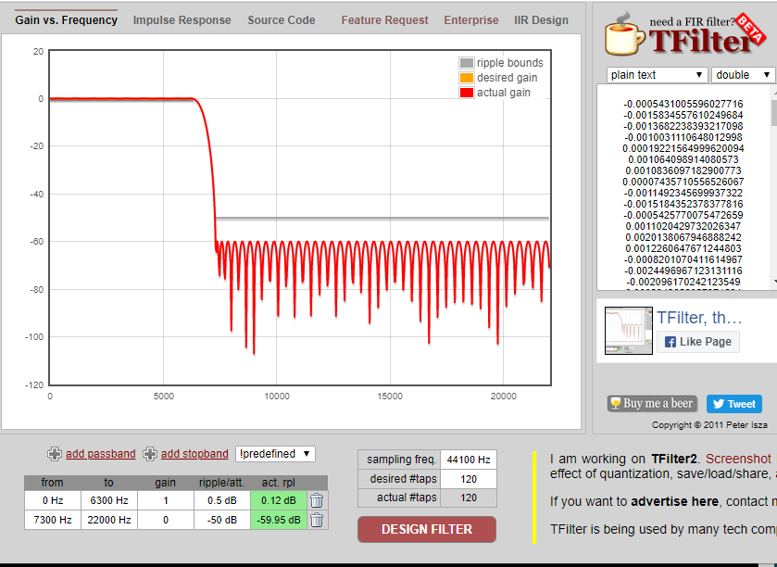
LP FIR Filter: (used 4 places in 6KHz BW)
0-6300 Hz 0dB, .12dB ripple
7300 -22000 Hz, -59.9dB 120 Taps

Slide 10
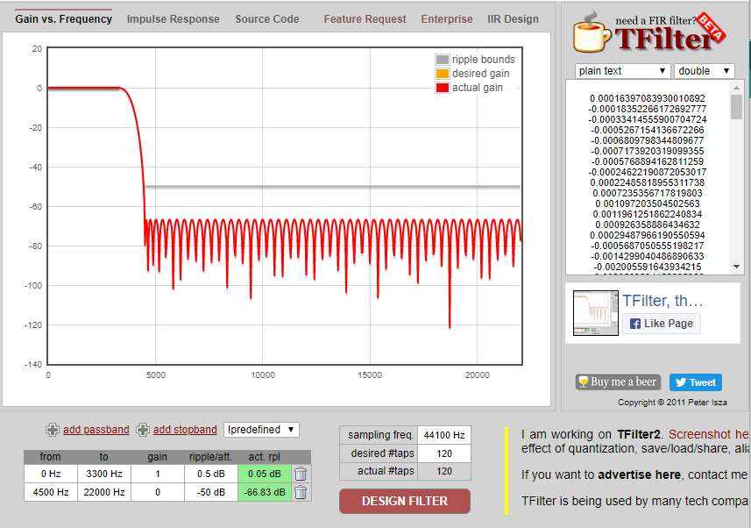
LP FIR Filter: (used 4 places in 3KHz BW)
0-3300 Hz 0dB, .05 dB ripple
4500 -22000 Hz, -66.8dB
120 Taps

Slide 11
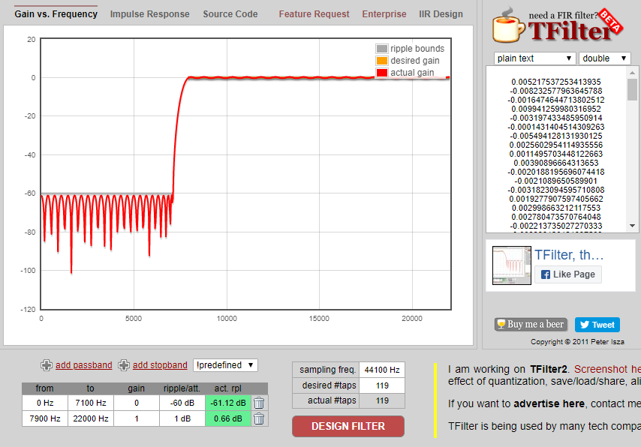
HP FIR Filter for Up Mixing:
0-7100 Hz –61dB
7900 -22000 Hz, 0dB, .66dB ripple
129 Taps
Nominal LO injection 7500 Hz

Slide 12
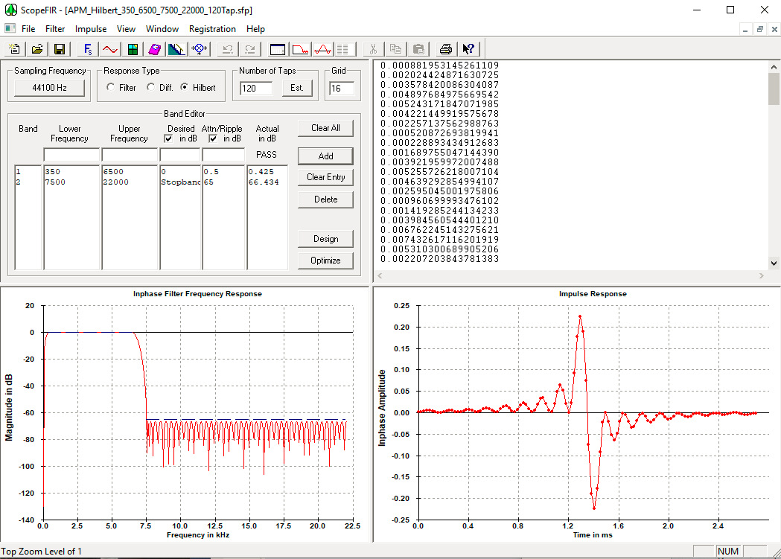
Hilbert FIR Filter: (used to Generate Q paths for multipath processing)
350-6500 Hz .43 dB ripple (used for both 3 and 6 KHz BW modes)
7500-22000 Hz –66 dB
120 taps, 1.3605 mS delay, (Scope FIR: Advanced PM)

Slide 13
User Interface
Goals: Easy to Learn (simple instructions)
Self contained and OS independent.
Manual control (knobs) or
External CPU control/readout via USB serial for automated testing
Approach
Simple user interface (color tft matrix screen and rotary encoders for “manual” setup and control.
Use existing Teensy micro USB interface for +5v power, USB serial control and display (~200 ma)
Common audio connections: 1/8” (3.5mm) stereo patch cords) for audio connections
Built in self test and calibration verification.

Slide 14
Manual User Interface
Left Encoder Right Encoder
MODE PARAMETER / Range /Power On Default*
WGN S:N /-40 to +40 ,1 dB steps/ +40
MPG S:N /-40 to +40 ,1 dB steps/ +40
MPM S:N /-40 to +40 ,1 dB steps/ +40
MPP S:N /-40 to +40 ,1 dB steps/ +40
MPD S:N /-40 to +40 ,1 dB steps/ +40
MULTIPATHS # of Multipaths used/ 2, 3, or 4/ 4
FADE DEPTH (dB) Depth of Fade dB/ 0 to 40 dB/ 0
FADE FREQ (Hz) Fade Frequency/0,.1,.2,.5,1,2,5,10,20,50,100/0 OFFSET (Hz) Freq Offset/-200 to +200 Hz, 10 Hz steps/0
FM DEVIATION(p-p, Hz ) FM Deviation/ 0,.1,.2,.5,1,2,5,10,20,50,100/0
FM RATE (Hz) FM Rate/ 0,.1,.2,.5,1,2,5,10,20,50,100/0
CH1 IN (Gain) Ch1 Input Gain/ 0, .1,.2,.5,1,2,5,10,20,50,100/2
CH2 IN (Gain) Ch2 Input Gain/ 0, .1,.2,.5,1,2,5,10,20,50,100/2
CH1 OUT (Level) Ch1 Output Level/ 0,.1,.2,.5,1,2,5,10,20,50,100/2
CH2 OUT (Level) Ch2 Output Level/ 0, .1,.2,.5,1,2,5,10,20,50,100/2
BANDWIDTH Audio bandwidth/3 KHz or 6 KHz/3
TEST3K Sine Test/Cal Measure Ch1,2, In p-p, Out p-p 3KHz BW
TEST6K Sine Test/Cal Measure Ch1,2, In p-p, Out p-p 6KHz BW
Common
Less used
Built in Test
* Except for Path S:N, power on default may be saved to EEPROM with push of right encoder

Slide 15
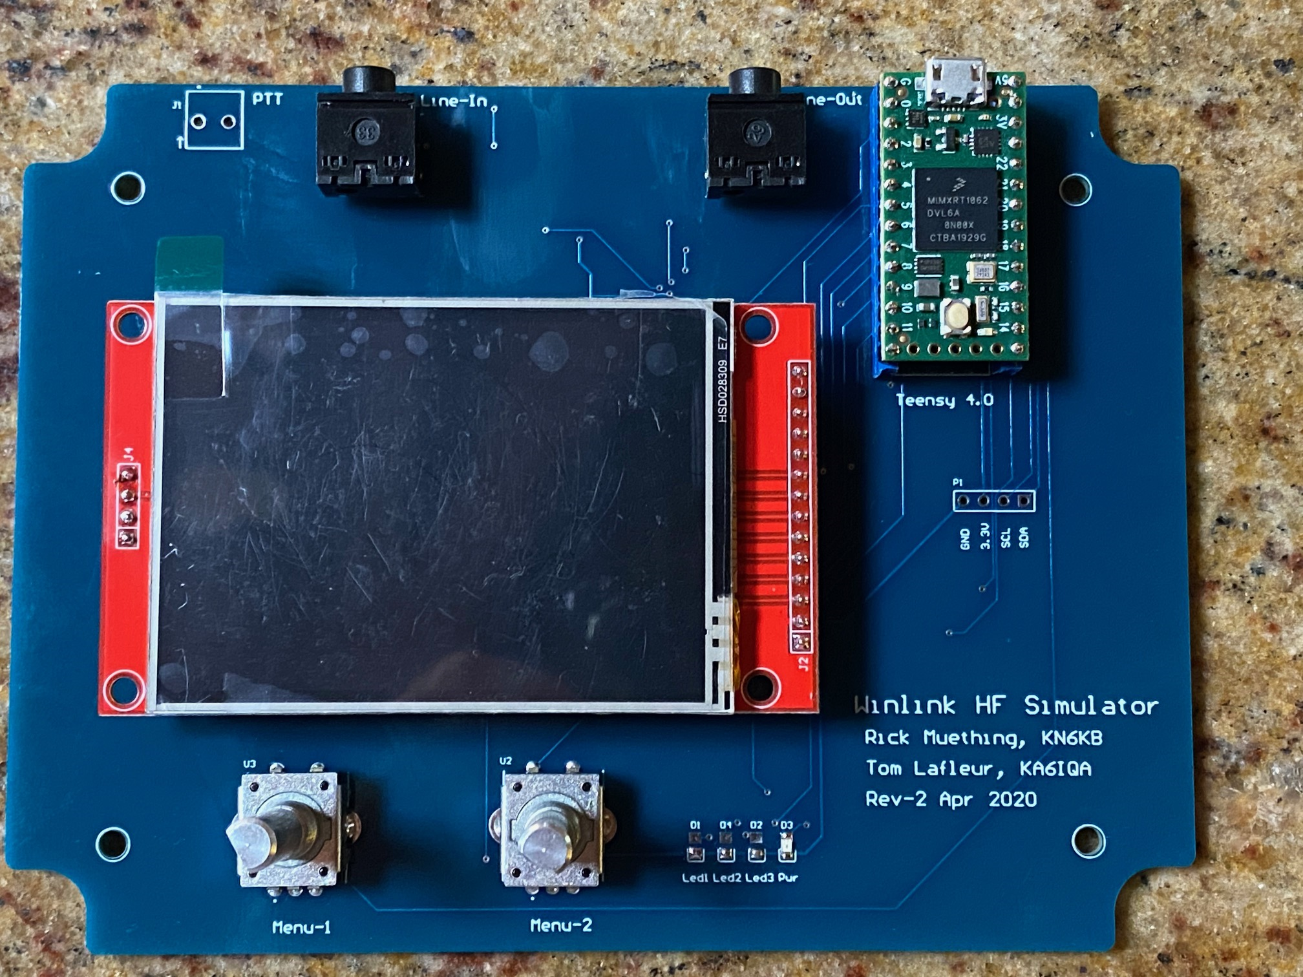
Photo of Rev 2 prototype
Color text/graphics
TFT Display 320 x 240 pixels
CH1,2 Audio In CH1,2 Audio Out
Micro USB, (Serial +5v Power)
Teensy 4.0
Sound Card chip and
Additional components
Mounted on back side
Of PCB.
(Teensy Audio Shield
not required)
Rotary Encoders
(mode / parameter)
Layout , assembly and photo by Tom Lafleur, KA6IQA

Slide 16

Photo of First production Run
Size: 6.1” x 4.7” x 1.4” (155 mm x 120 mm x 36 mm) (excluding knobs)

Slide 17
Simulator USB Serial User Interface
USB Serial Commands and Responses for automated testing
(Mimic manual commands from Mode and Parameter Encoders)
Command (case insensitive, End with Cr) Acknowledge Response/ Interpretation
WGN:20 OK(Cr) or ?(Cr) / WGN +20dB S:N
MPG:20 OK(Cr) or ?(Cr) / MPG +20dB S:N
MPM:-10 OK(Cr) or ?(Cr) / MPM -10dB S:N
MPP:+20 OK(Cr) or ?(Cr) / MPP +20dB S:N
MPD:20 OK(Cr) or ?(Cr) / MPD +20dB S:N
MULTIPATH: 4 OK(Cr) or ?(Cr) / # of multipaths used
FADE DEPTH:10 OK(Cr) or ?(Cr) / FADE DEPTH:10 dB
FADE FREQ:10 OK(Cr) or ?(Cr) / FADE FREQ:(log)7 Hz OFFSET:100 OK(Cr) or ?(Cr) / OFFSET: 100 Hz
FM DEVIATION:10 OK(Cr) or ?(Cr) / FM DEVIATION:(log)7Hz
FM RATE:.1 OK(Cr) or ?(Cr) / FM RATE:(log)7 Hz
CH1 IN:0-10 OK(Cr) or ?(Cr) / CH1 IN gain,(log)7
CH2 IN:0-10 OK(Cr) or ?(Cr) / CH2 IN gain,(log)7
CH1 OUT:0-10 OK(Cr) or ?(Cr) / CH1 OUT gain,(log)7
CH2 OUT:0-10 OK(Cr) or ?(Cr) / CH2 OUT gain,(log)7
BANDWIDTH:3000 OK(Cr) or ?(Cr) / BANDWIDTH = 3KHz
BUSY: OK(Cr) or ?(Cr) / ENABLE BUSY DETECT
Note: 1. All commands case insensitive. “+” signs ignored.
2. All commands and replies terminate with (Cr).
3. “OK” reply indicates command was interpreted OK and executed.
4. “?” reply indicates command was not understood, corrupted or out of range.
5. Commands must be sequenced by sender using Acknowledge Response
6. Successful commands will update Mode/Parameter display
7.Values 0 to 10 correspond to log gain/level values of 0.0, .1, .2, .5, 1, 2, 5, 10, 20. 50, 100

Slide 18
Busy Detect USB Serial User Interface
USB Serial Commands and Responses for using busy detector
(note no encoder selection for these modes and parameters,
all control and reporting via USB serial)
Command (case insensitive, End with Cr) Acknowledge Response/ Interpretation
ENB BUSY:1-50 OK(Cr) or ?(Cr) / Enable busy detect avg 1-50 7
DIS BUSY:0 OK(Cr) or ?(Cr) / Disable busy detect
LOW:500 OK(Cr) or ?(Cr) / FFT Low Limit 43-5000 Hz
HIGH:4000 OK(Cr) or ?(Cr) / FFT High Limit 500-6000 Hz 6
THRESH:10 OK(Cr) or ?(Cr) / dB Peak above avg (3-40 dB)
TONE ON: 1500 OK(Cr) or ?(Cr) / Enable Test tone 43- 6300 Hz
TONE OFF: OK(Cr) or ?(Cr) / Disable test tone (normal use)
CH1 IN:0-10 OK(Cr) or ? (Cr) / Set input CH1 Gain 0-100 (log)8
BANDWIDTH;3000/6000 OK(Cr) or ?(Cr) / Set bandwidth Hz
SPECTRUM:1/0 OK(Cr) or ?(Cr) / Enable/Disable spectrum disp.
SIM: OK(Cr) or ?(Cr) / Switch to simulator mode
notifications to application FROM Busy Detector
DETECT:6 OK(Cr) or ?(Cr) /BUSY DETECT peak level in dB
DETECT:0 OK(Cr) or ?(Cr) / NON BUSY CONDITION DETECTED
Note: 1. All commands case insensitive. “+” signs ignored.
2. All commands and replies terminate with (Cr).
3. “OK” reply indicates command was interpreted OK and executed.
4. “?” reply indicates command was not understood, corrupted or out of range.
5. Commands must be sequenced by sender using Acknowledge Response
6. HIGH must be at least 260 Hz above LOW
7. # of Averages. Larger number reduces noise fluctuation at the cost of higher detection latency.
8. Values 0-10 correspond to Log gain steps 0.0, .1, .2, .5, 1, 2, 5, 10, 20, 50, 100 CH2 IN gain forced to 0.

Slide 19

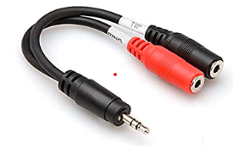
Connecting the simulator: 1 Simulator
Half Duplex, Channels will be symmetric
Modem 1
Modem 2
Key/PTT
Audio In
Audio Out
Not used
Not used
Key/PTT
Audio In
Audio Out
1
2
1
2
Split Left and Right
STEREO outputs or use
STEREO to MONO splitter
Split Left and Right
STEREO inputs
Line In 1, 2
Line Out 1, 2
Use standard 1/8” (3.5mm) 3 conductor Stereo Plugs

Slide 20

Connecting the simulator: 2 Simulators
Full Duplex, non symmetric channels:
Modem 1
Modem 2
Key/PTT
Audio out
Audio In
Not used
Not used
Key/PTT
Audio out
Audio In
Set unused channel
In and Out gains to 0
Set unused channel
In and Out gains to 0
Line Out 1
Line In 1
Line Out 1
Line in 1
Simulator Channel
Setups may be
different
Sim #1 (modem 1 >2)
Sim #2 (modem 2 >1)

Slide 21
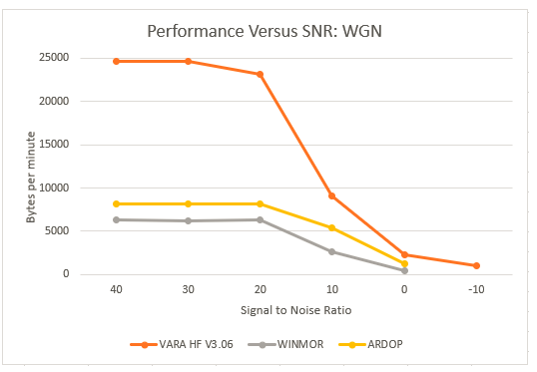
Example HF Use: 3 HF sound-card protocols, WGN -10 to +40 dB S:N
Tests performed by Tom Whiteside N5TW

Slide 22
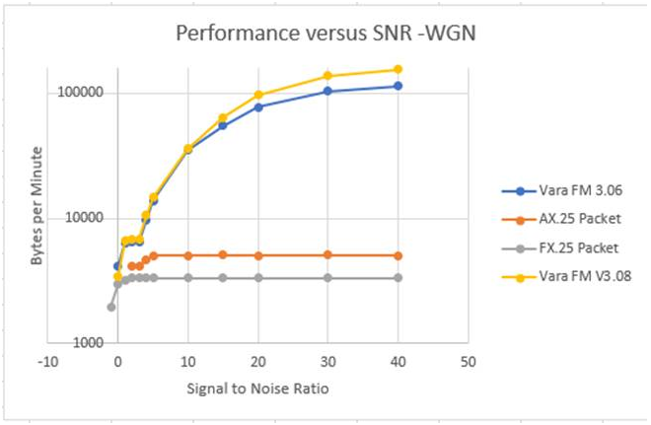
Example VHF FM Use: 4 VHF sound-card protocols, WGN -3 to +40 dB S:N
Tests performed by Tom Whiteside N5TW

Slide 23
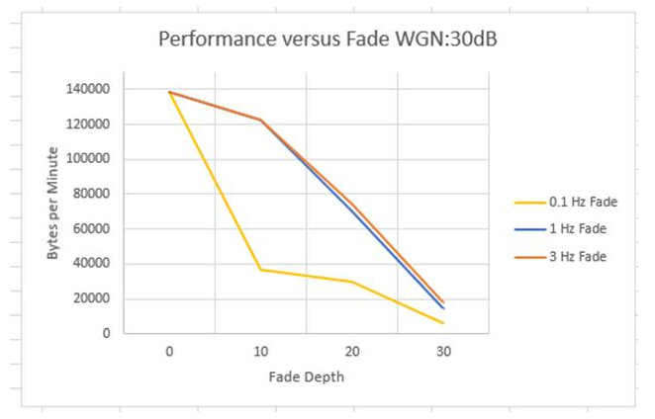
Example VHF FM Use: VARA FM (3.06)
WGN 30 dB S:N with deep flat fading
(.1, 1, 3 Hz fade rates)
Tests performed by Tom Whiteside N5TW

Slide 24
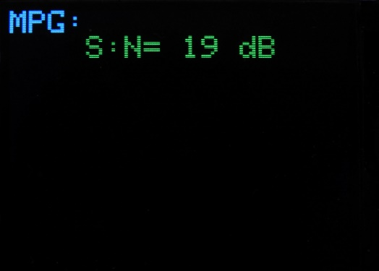
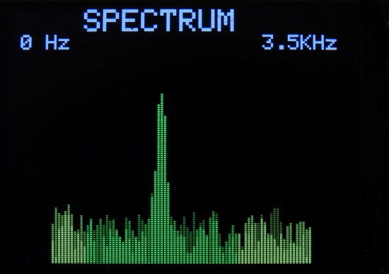
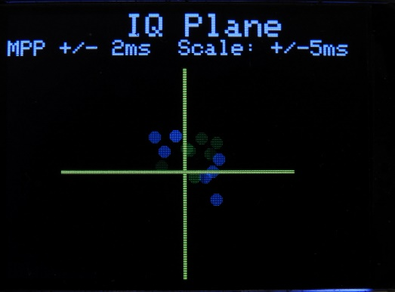
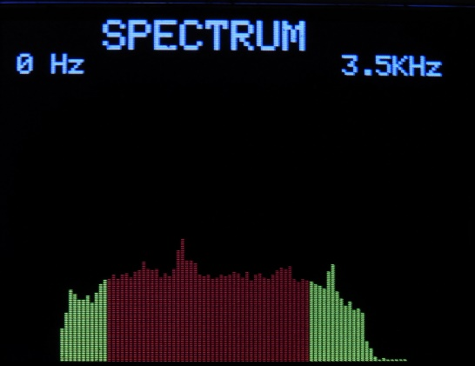
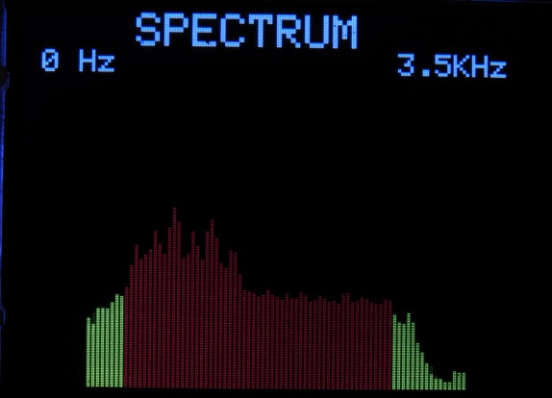
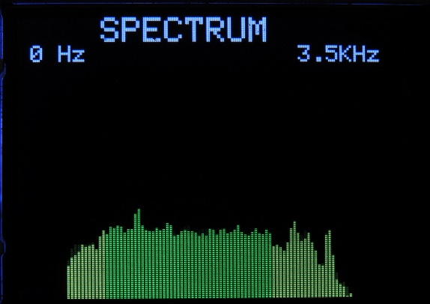
Example TFT Screen Shots
Mode/Parameter
Setup example
(similar for all modes
and parameters)
Spectrum Display 3.5KHz
1500 Hz tone @ 19dB S:N
IQ Plane Dynamic Delay Plot
Multi Path Poor, +/- 2ms
Busy Detector
Narrow Band Detect (CW)
Busy Detector
Wide Band Detect (SSB voice)
Busy Detector
Channel Clear Detect

Slide 25
Status 4/29/2020
All functions of simulator coded and tested using Rev 2 prototype PCB. Teensy Audio shield not needed.
Approximately 1900 lines of code (Rev .9.9.3) using 6% program and 30% RAM memory.
6 Rev 2 Prototypes completed . 25 Rev 2 Beta prototypes in build and test
Color graphics display (240x320 pixels ) used for Modes/Parameters, Spectrum and IQ Delay Plane plots.
USB Serial commands for Simulator and Busy Detect operational
Simulator Testing on Packet, VARA FM VHF, VARA HF, Pactor 3, Pactor 4, ARDOP, WINMOR in process by Tom, N5TW
Connection and operational documentation complete.
Mechanical drawings (case drill/route guides) complete
Auto Test and Calibration: 3KHz, 6 KHz complete.
Silk screen and mechanical drawings complete
Documentation and manual with specification complete
Remaining work:
Complete and document testing with additional HF/VHF modems.

